Slide 1
Cohen chap 2. frequency tables, graphs, & distributions
For EDUC/PSY 6600

Slide 2
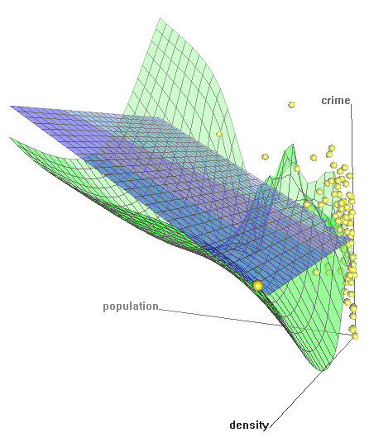
ALWAYS plot your data first ! ! !
ALWAYS PLOT YOUR DATA 1st!
Graphical method ↔ Level of measurement
Label all axes, include figure caption!!!
Simplicity and clarity
Avoid of ‘chartjunk’
Unless there are 3 or more variables, avoid 3D figures
Black & white, grayscale/pattern fine for most simple figures
Figure 1. 3-D scatterplot with smoothed surface depicting relationship among violent crime, population, and population density in urban US cities, 2005 (N = 110).

Slide 3
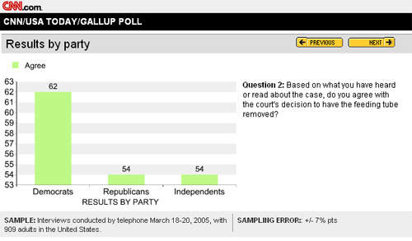
Data visualization
Most abused area of quantitative science: Making misleading charts and figures
“If you can’t convince them, confuse them!”
President Harry S. Truman

Slide 4
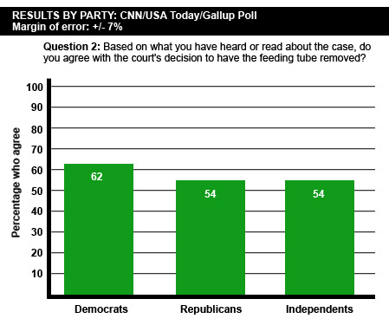
Revised…

Slide 5
Why plot your data?
Outliers and impossible values
Determine correct statistical approach
Assumptions and diagnostics
Discover new relationships

Slide 6
Frequency distributions
Counting the number of occurrences of unique events
Categorical or continuous
Can see central tendency (continuous data) or most common value (categorical data)
Can see range and extremes

Slide 7
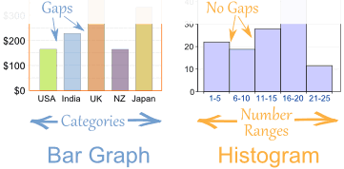
BAR GRAPH
Graphical frequency distribution for DISCRETE variables
Bars
Do NOT touch each other
Begin and terminate at real limits
Centered on the value
Height = frequency
HISTOGRAM
Graphical frequency distribution for continuous variables
Bars
Touch each other
Begin and terminate at real limits
Centered on interval midpoint
Height = frequency
Interval size or ‘bin’ determines shape
Too narrow or too wide problematic
Useful for checking distributional assumptions

Slide 8
Histogram - examples
Figure 2. Histogram of violent crime incidents in major U.S. cities, 2005 (N = 110).
Figure 3. Histogram of energy expenditure by lean (n = 11) and obese athletes (n = 11).

Slide 9
Stem-and-Leaf Display
1 | 2: represents 12
leaf unit: 1
n: 50
1 -0 | 3
2 0 | 46
2 1 | 68
8 2 | 01467999
9 3 | 456779999
(10) 4 | 0012334678
7 5 | 0022347
5 6 | 02399
5 7 | 01558
1 8 | 0
Histogram on side
Continuous data
Each score represented by stem and leaf
Best when N < 100

Slide 10
What do we mean by Distribution?
For a Continuous variable
General shape
Exceptions (outliers)
Modes (peaks)
Center & spread (chap 3)
Histogram
Cumulative polygon or ogive
For a Categorical variable
Counts = raw number of ___ Percent or Rate - adjusts for an ‘out of’ to compare
Bar chart – should have space between bars, order?
Pie chart - avoid!

Slide 11
“Cancer” Dataset for SPSS DEMO
The data set contains part of the data for a study of oral condition of cancer patients conducted at the Mid-Michigan Medical Center.
The oral conditions of the patients were measured and recorded at the initial stage, at the end of the second week, at the end of the fourth week, and at the end of the sixth week.
The variables age, initial weight and initial cancer stage of the patients were recorded.
Patients were divided into two groups at random: One group received a placebo and the other group received aloe juice treatment.
Sample size, n = 25 patients with neck cancer.

Slide 12
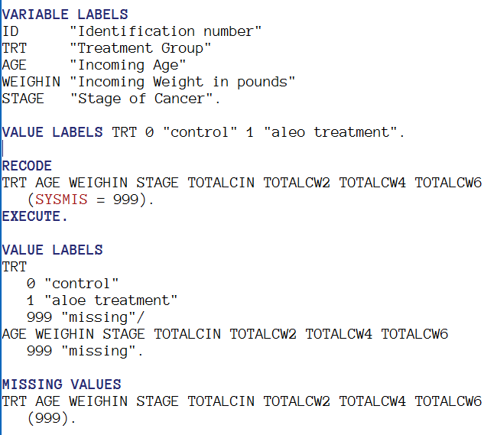
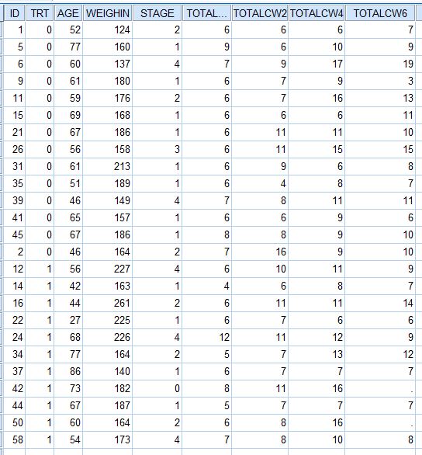
Prep the dataset

Slide 13
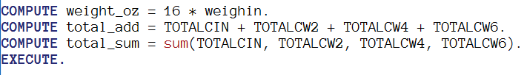
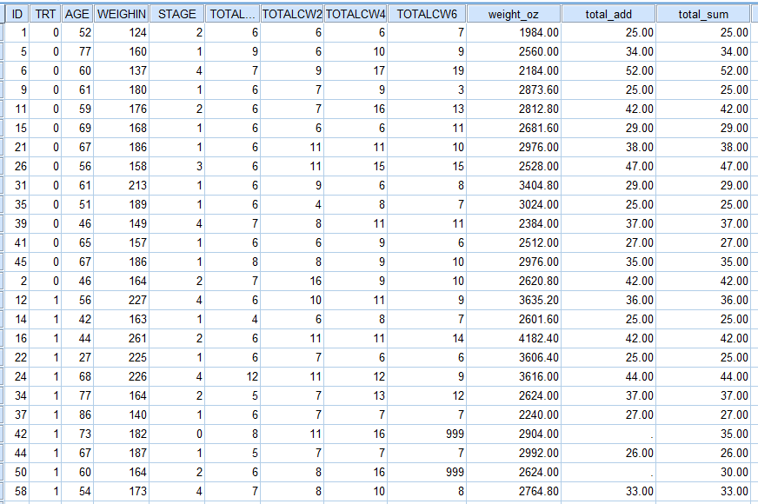
new variable

Slide 14


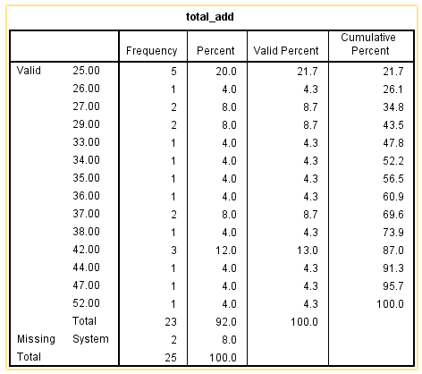
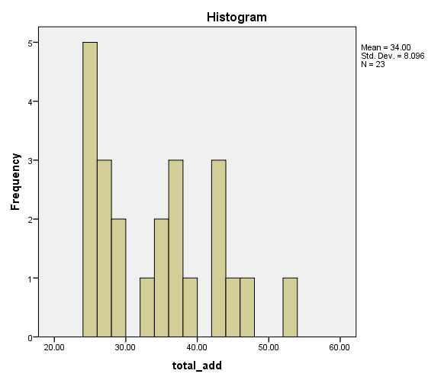
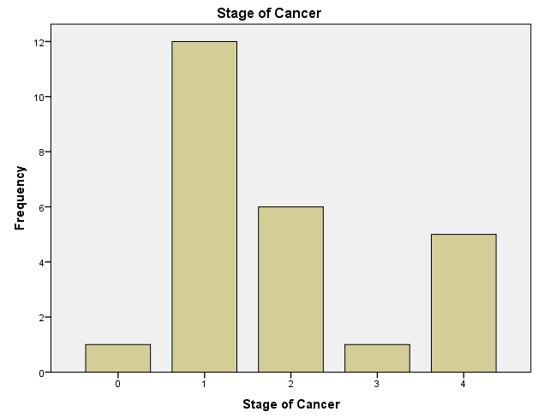
SPSS: the multipurpose “frequencies” command
Frequency Table | Histogram | Barchart

Slide 15

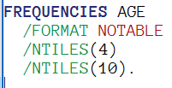

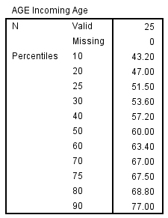
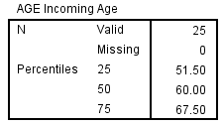
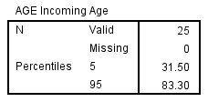
SPSS: another “frequencies” use
Quartiles | n’tiles | Percentiles

Slide 16
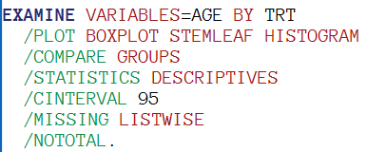
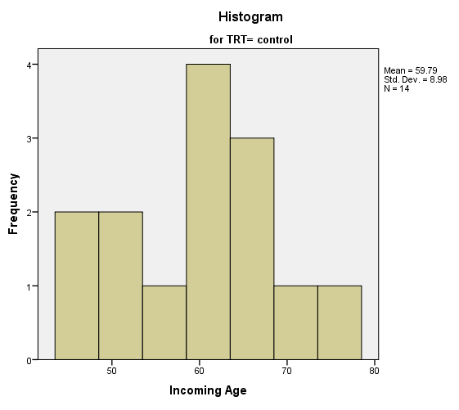
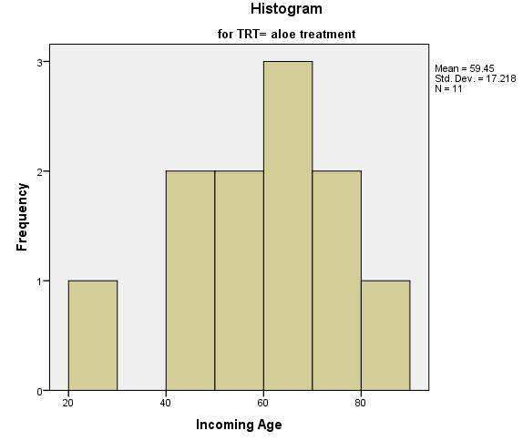

SPSS: compare groups w/”examime”
What you get out of the menu window
Minimal code with defaults

Slide 17


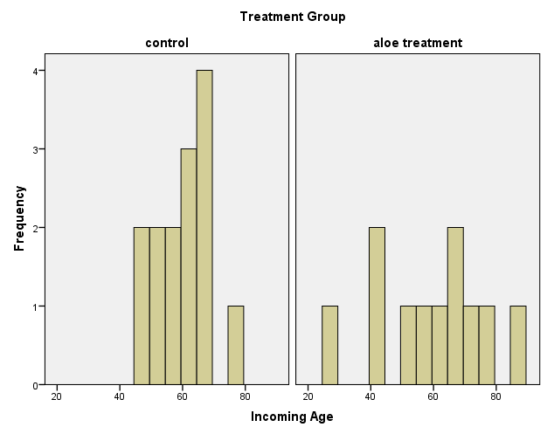
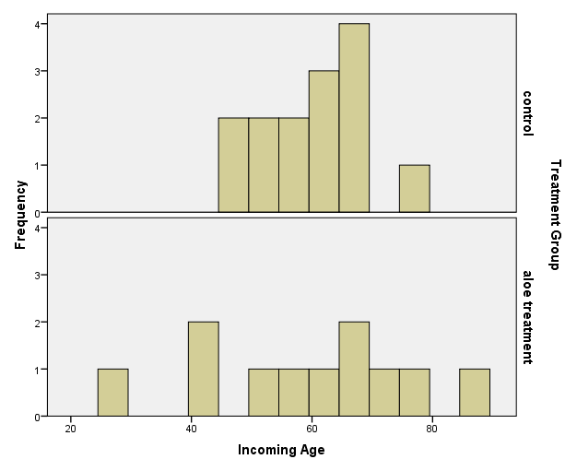
SPSS: compare groups w/”Graph” & “PANEL” combo

